Slide 1

Employee Performance Analysis for INX Future Inc.

Slide 2
Project summary
INX Future Inc. Known as INX, Is a leading data analytics and automation solutions provider. Recently the top management has had growing concerns over the unhealthy employee performance indexes. A data science project by Mr. Brian, the CEO, was initiated to look into this. It will analyze the current employee data and find the underlying causes of the performance issues.
The expected insights include:
1.Department wise performances.
2.Top 3 important factors affecting employee performance.
3.A trained model which can predict the employee performance based on factors as inputs.
4.Recommendations to improve the employee performance based on insights from the analysis.
Requirement
Third party data sources. The dataset was provided by IABAC via a link: http://data.iabac.org/exam/p2/data/INX_Future_Inc_Employee_Performance_CDS_Project2_Data_V1.8.xls

Slide 3
Analysis
The data is structured and is supervised. The variables have both numerical and categorical data. 19 are numerical and 9 are categorical. The target variable is performance rating.
Processing techniques incorporated are checking for missing values, checking for duplicates and unique values, handling of outliers, encoding categorical variables to transform them into numbers and scaling the data. Analysis by tables and visualization. First statistical analysis was done to understand the data distribution. Then visualization of numerical data via histograms, then visualization of categorical data via histograms too.
For feature selection, two methods are applied. Correlation analysis and use of random forest. This is because we want to get the important factors, then analyze their relation to performance rating. Under correlation, it shows a linear relationship and the features with a correlation of more than one selected. With random forest, there's use of feature importance.
Based on the data and expected insights, this is a classification problem. The models evaluated are decision tree, random forest and KNeighbors. Definition of dependent and independent variables was done. We find that the target variable has imbalance so to balance it out SMOTE was used. There were variables with infinite values so this was handled by replacing them with mean. Hyper parameter tuning is done on selected model, random forest.
Summary
The project was done with the purpose of finding out factors which affected the Performance of the employees, department wise performance, training a model which accurately predicts the Performance Rating of the employee and analyzing the data to provide recommendations to improve the performance and gain insights from the analysis.
Cont.

Slide 4
Cont.
Department wise performance insights :
Individual employee performance and top 3 features in departments were visualized by the use of tableau. Screenshots attached. Insights from the visualizations; Development team has the highest mean performance of 3.09. Data science has the lowest count (1 person) of the lowest performance (a rating of 2); also the lowest count (2 people) of the highest performance (rating of 4).Development has the highest count (44 people) of the highest performance rating which is a 4. Sales has the highest count (87 people) of the lowest performance rating (a 2).Development and Research and development have the highest number of people with high environment satisfaction ratings. Data science has the least. Sales has the highest least percentage of salary hike at 16%. Development, finance, research and development and sales have the highest salary hike percentage of 25%. Development, Research and development and sales have the highest number (15) of years since last promotion while Data science has the least(7 years). Development, Research and development and Sales have promotions yearly.
Top 3 features :
The most important features selected are Department, Job role, Environment satisfaction, Last salary hike percent, Work-life balance, Years at this company, Years in current role, Years since last promotion and Years with current manager.
Top three features from correlation analysis are Environment satisfaction, last salary hike percent and work life balance. Random forest gave environment satisfaction, last salary hike percent and years since last promotion. Since we want to build a predictive model that uses multi-linear correlations, we will use the results under random forest.
Model training and selection :
Classification analysis is carried out because although the performance has a range of 1-4, the performance data only has 3 classes i.e. 2,3,4.
The models accuracies were (cont.)
Cont.

Slide 5
Cont.
Decision tree with parameters = 88.57% Decision tree without parameters = 93.14%
Random forest with parameters = 96.38% Random forest without parameters = 96.19%
KNeighbors with parameters = 91.24% KNeighbors without parameters = 88.57%
The machine learning model selected after training is random forest with parameter after hyper parameter tuning. It has an accuracy score of 96.38% and slightly better F1-Scores for Class 0 and Class 2. This is deployed with streamlit.

Slide 6
Data set overview
The dataset was provided by IABAC.
It contains 28 columns or attributes. 19 are numerical and 9 are categorical.
There are no null values and no duplicates.
v
Data set features:
Age, Gender, Education background, Marital status, Department, Job role, Business travel frequency, Distance from home, Education level, Environment satisfaction, Hourly rate, Job involvement, Job level, Job satisfaction, Number of companies worked, Overtime, Last salary hike percent, Relationship satisfaction
Total work experience in years, Training times last year, Work-life balance, Experience years at this company, Experience years in current role, Years since last promotion, Years with current manager, Attrition and Performance rating
Cont.

Slide 7
Cont.
There are more males than females in the organization.
Most employees have a life sciences education background, followed by medicine.
Married employees are more than singles and divorced.
Sales has the highest number of employees while data science has the least.
Most of the employees rarely travel, a moderate number frequently travel while the rest do not travel.
There are more employees who do not work overtime compared to those who do.
The number of employees who would leave the company(attrition) are far less than those who would stay.
Ages range between 18 to 60, 36 being the median.
Education level has a mean of 2.89, indicating averagely the employees have gotten to college level of education.
Environment and job satisfaction of employees ranges between 1 to 4.
The hourly rate is between 30 to 100.
Last salary hike percent is between 11% to 25%. The average percentage being 15.22%.
Work experience is between 0 to 40 years. The average is at 11 years which shows the company has moderately experienced staff.
Years at the company is between 0 to 40. Averagely employees have been with the company for about 7 years.
Years at current role ranges between 0 to 18 years. Employees averagely spend 4.29 years in one role.
Years since last promotion ranges between 0 to 15 years. Averagely promotions are given every 2.19 years.

Slide 8
Data definitions
Gender | Male | 1
 | Female | 2
Education Background | Human Resources | 0
 | Life Sciences | 1
 | Marketing | 2
 | Medical | 3
 | Other | 4
 | Technical Degree | 5
Marital Status | Divorced | 0
 | Married | 1
 | Single | 2
EmpDepartment | Data Science | 0
 | Development | 1
 | Finance | 2
 | Human Resources | 3
 | Research & Development | 4
 | Sales | 5
EmpJobRole | Business Analyst | 0
 | Data Scientist | 1
 | Delivery Manager | 2
 | Developer | 3
 | Finance Manager | 4
 | Healthcare Representative | 5
 | Human Resources | 6
 | Laboratory Technician | 7
EmpJobRole | Manager | 8
 | Manager R&D | 9
 | Manufacturing Director | 10
 | Research Director | 11
 | Research Scientist | 12
 | Sales Executive | 13
 | Sales Representative | 14
 | Senior Developer | 15
 | Senior Manager R&D | 16
 | Technical Architect | 17
 | Technical Lead | 18
BusinessTravelFrequency | Non-Travel | 0
 | Travel_Frequently | 1
 | Travel_Rarely | 2
OverTime | No | 0
 | Yes | 1
Attrition | No | 0
 | Yes | 1
Cont.

Slide 9
Cont.
EmpEducationLevel | Below College
 | College
 | Bachelor
 | Master
 | Doctor
EmpEnvironmentSatisfaction | Low
 | Medium
 | High
 | Very High
EmpJobInvolvement | Low
 | Medium
 | High
 | Very High
EmpJobSatisfaction | Low
 | Medium
 | High
 | Very High
PerformanceRating | Low
 | Good
 | Excellent
 | Outstanding
RelationshipSatisfaction | Low
 | Medium
 | High
 | Very High
EmpWorkLifeBalance | Bad
 | 2Good
 | Better
 | Best
1
2
3
4
5
1
2
3
4
1
2
3
4
1
2
3
4
1
2
3
4
1
2
3
4
1
2
3
4

Slide 10
Libraries used
Data visualization and manipulation:
Pandas
Numpy
Seaborn
Matplotlib
Machine learning:
Sci-kit learn – label encoder, metrics, random forest classifier, decision tree classifier, KNeighbors, standard scaler, train test split.
Warnings

Slide 11
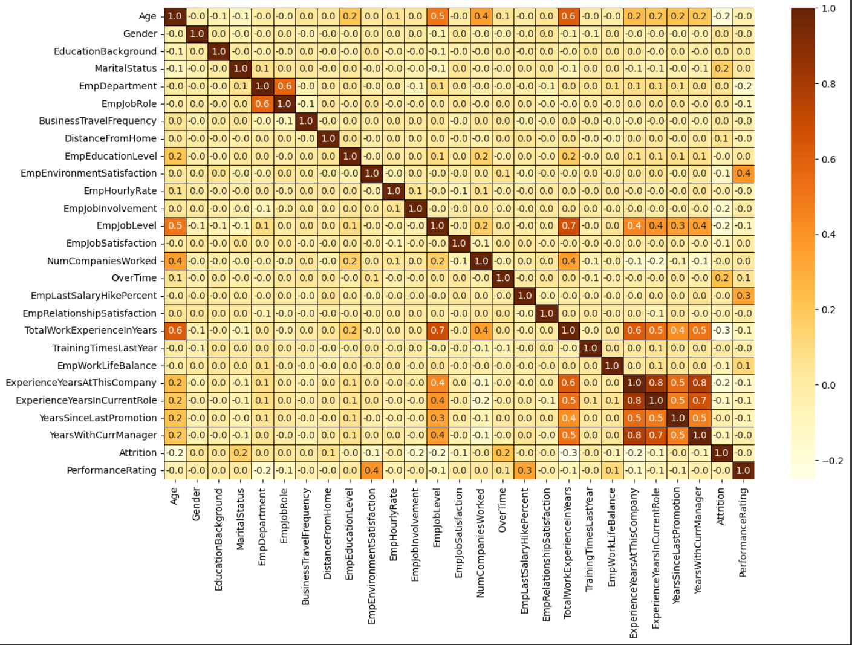
Correlation Analysis
Features with a correlation of 0.1 and above to performance are:
Department
Job role
Environment satisfaction
Last salary hike percent
Work-life balance
Years at this company
Years in current role
Years since last promotion
Years with current manager

Slide 12
Machine learning model
Random forest classifier
Random Forest is an ensemble learning method that constructs multiple decision trees and combines their predictions to improve overall performance and reduce overfitting. It works by training each tree on a random subset of the data and using a random subset of features for each split, resulting in a diverse set of trees that generalize better to new data.
The model selected had an accuracy score of 96.38%. Decision tree had an accuracy score of 93.14% while KNN had 94.21%.
Further scores for the random forest model chosen are as follows, for the three classes
Class precision recall f1-score
2 0.96 0.97 0.97
3 0.95 0.94 0.95
4 0.98 0.98 0.98
The model also has 179 true positives for class 2, 163 true positives for class 3 and 164 true positives for class 4. 5 class 2 predicted as class 3, no class 2 predicted as class 4, 6 class 3 predicted as class2, 4 class 3 predicted as class 4, 1 class 4 predicted as class 2 and 3 class 4 predicted as class 3.

Slide 13
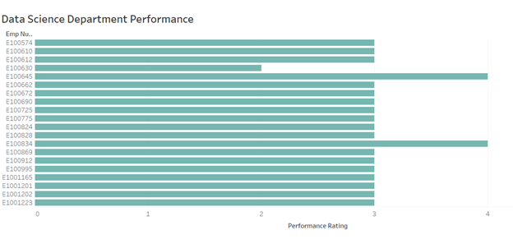
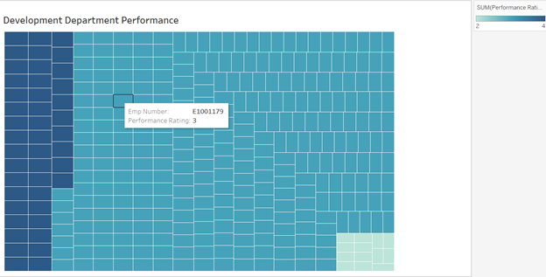
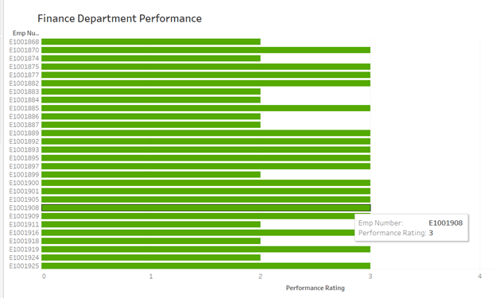
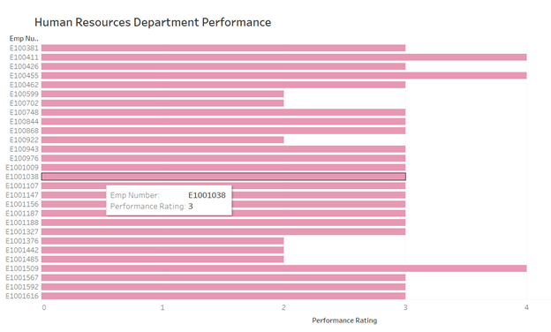
Visualizations

Slide 14
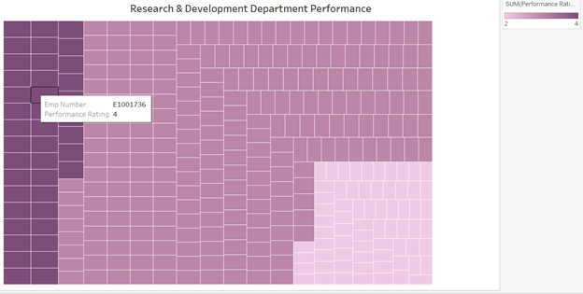
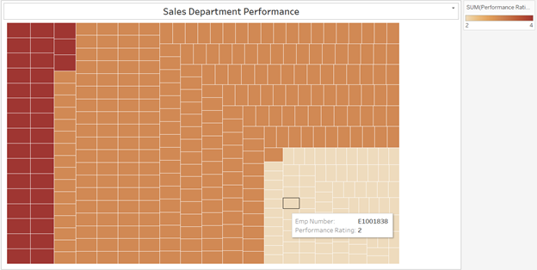
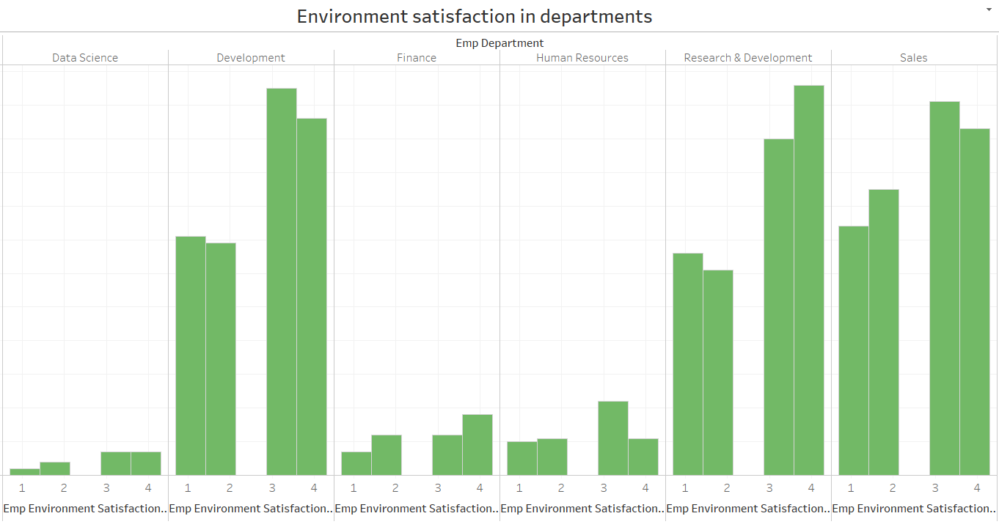
Cont.

Slide 15
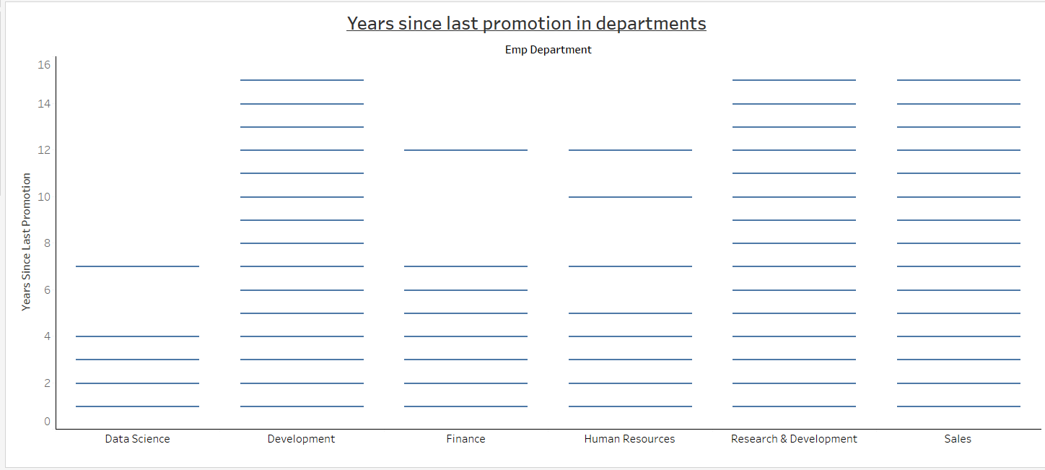
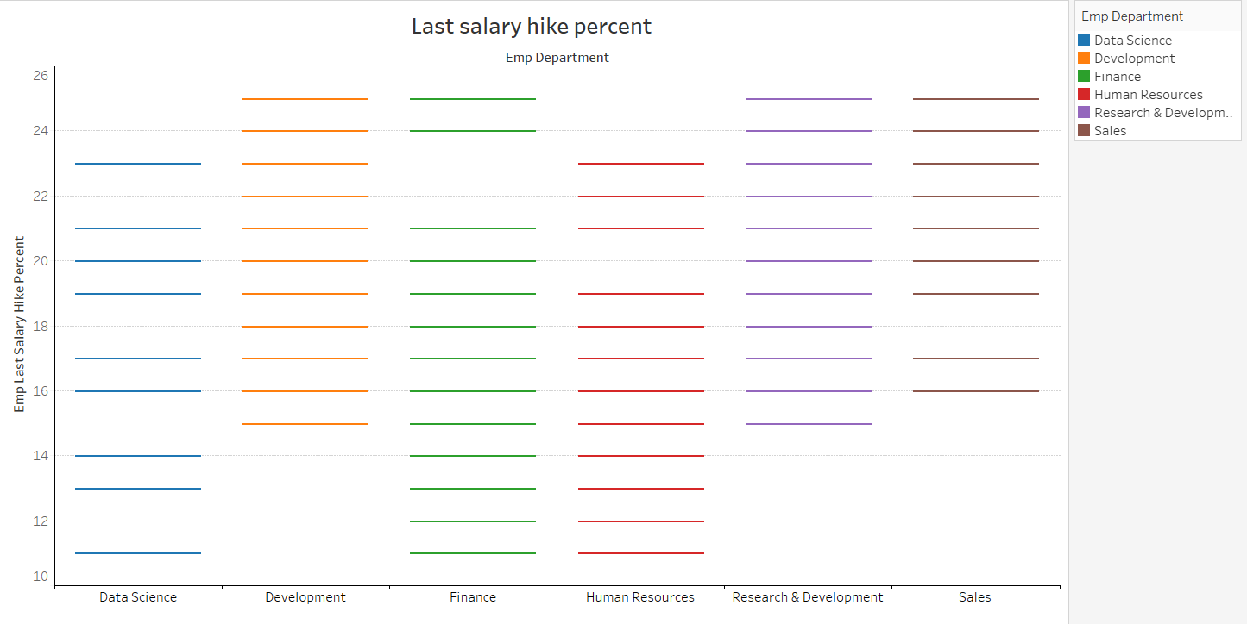

Slide 16
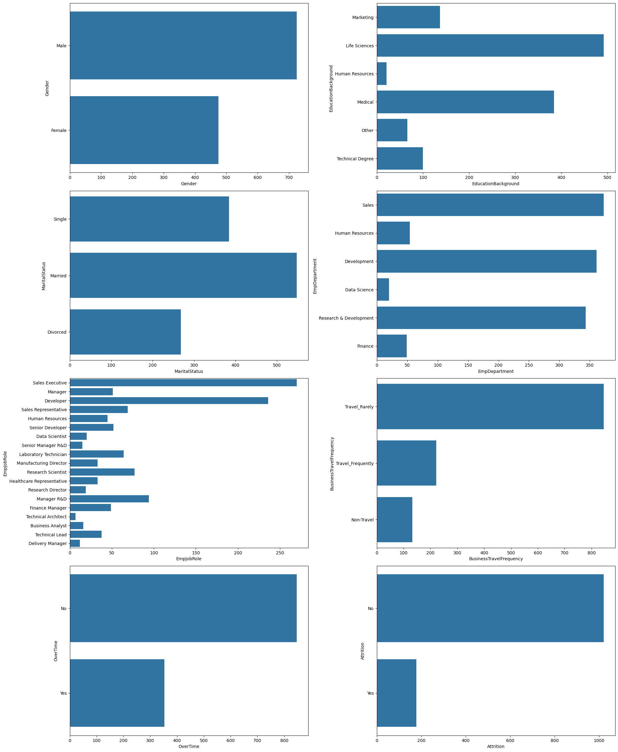

Slide 17
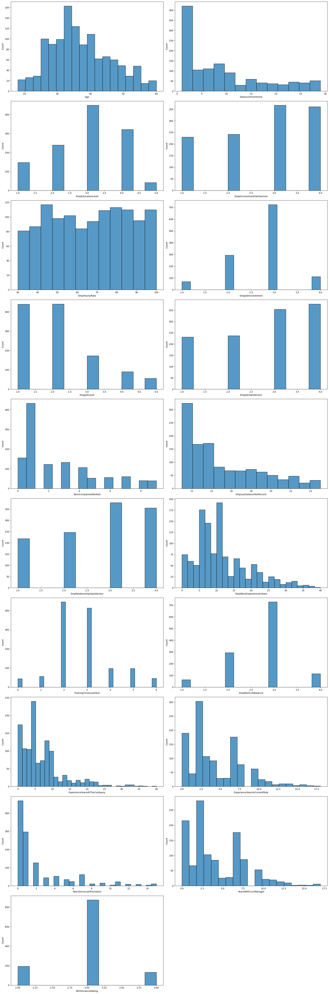

Slide 18
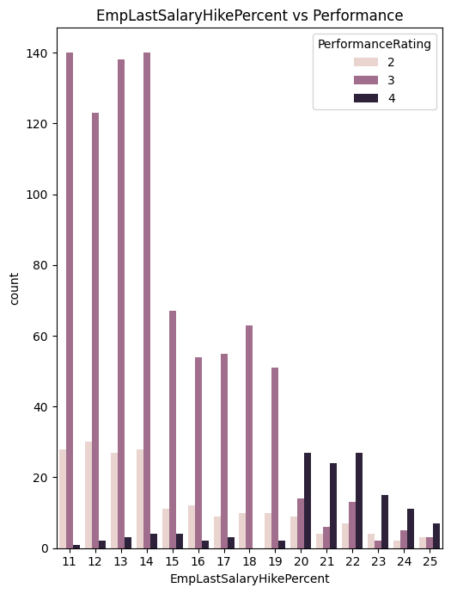
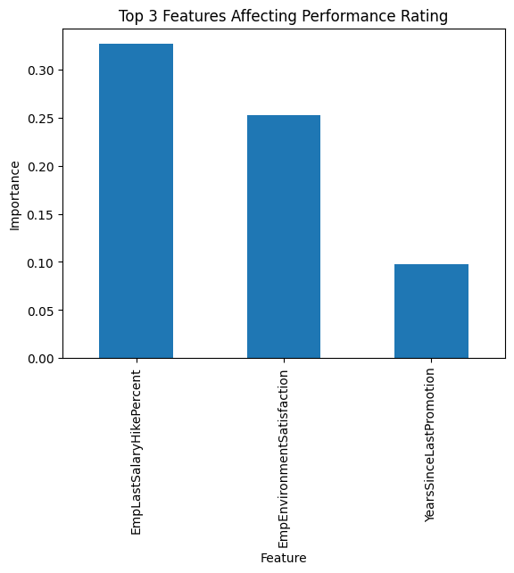
Cont.

Slide 19
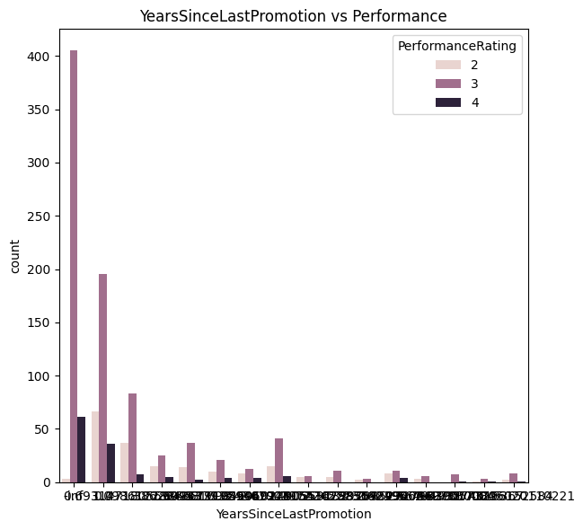
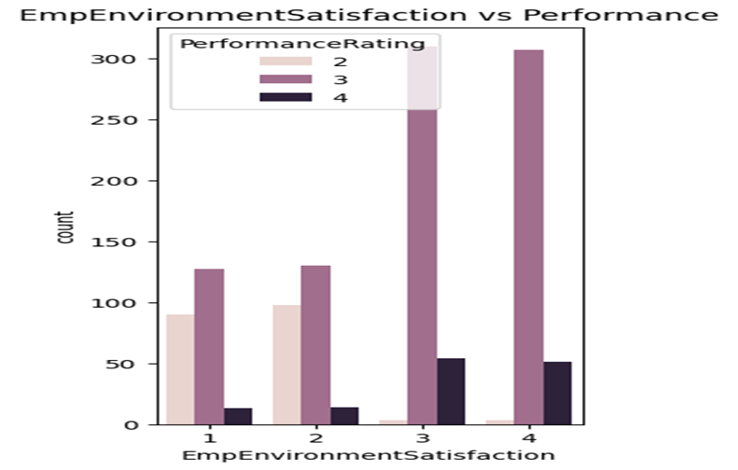
Cont.

Slide 20
Recommendations :
Improve environment satisfaction as it is a top factor affecting performance. This can be done through giving channels for feedback per department and addressing matters raised. Targeted training for low performing individuals/departments. The company should give promotions at least every 1 to 2 years. Improve work life balance. We saw that those working overtime have a higher attrition rate. Salary hike will give the boost to the employees to perform well so clear indications on how salary increments are done should be given. Shuffling of managers every 3 years can also improve performance. Experience in current job role should be considered while employing new employees. The development team has highest performing employees, the company can leverage what the department does differently to other departments. Get feedback from employees who have low job satisfaction yet perform highly.
Conclusions :
The model can be moderately used to predict employee performance. Traditional methods like business score cards can be used to measure performance alongside it. Continuous improvements to it should be done regularly with new insights and data acquired from employees.
References:
Chat GPT
AfriCDSA Machine Learning | Notes sorted by date (notion.site)

